Slide 1
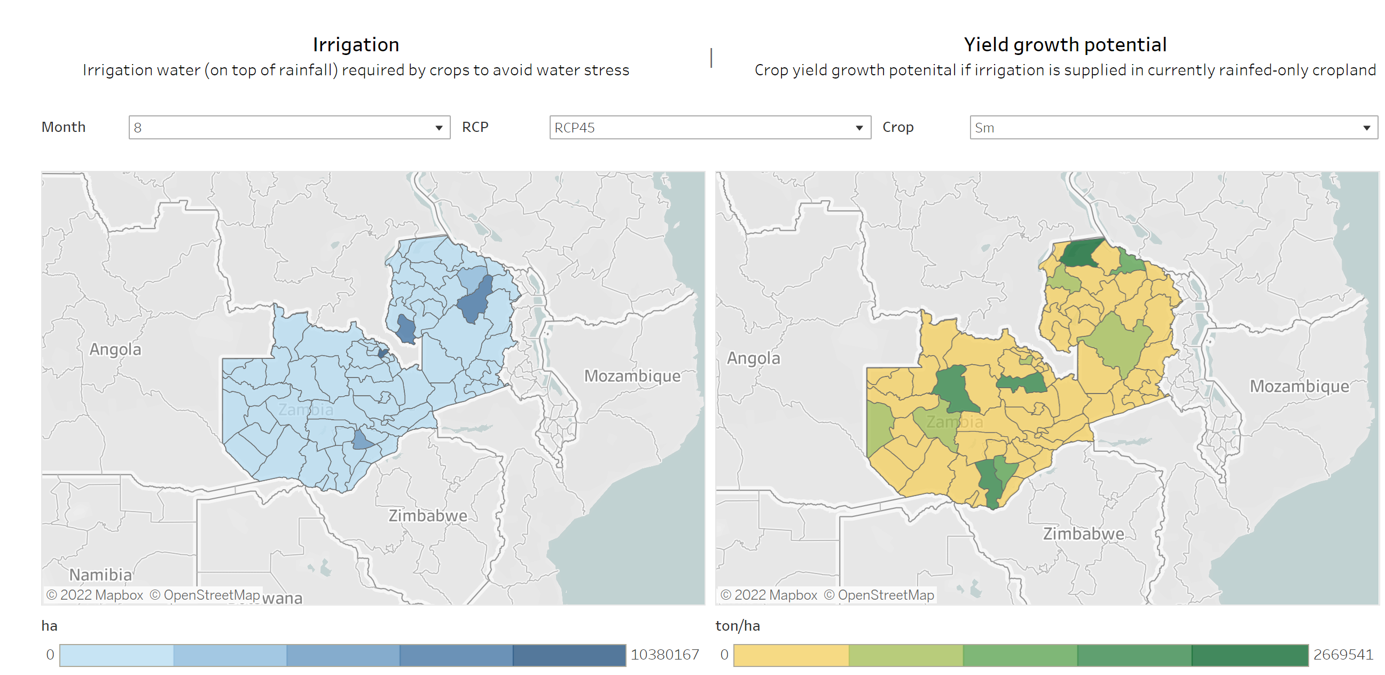
RE4AFAGRI dashboards – current situation
Current alpha version uses Tableau, which is fine for few polygons. Tableau allows integrated development of dropdown menus and responsive maps:
But it is highly inefficient for visualising many features...

Slide 2
RE4AFAGRI dashboards – desired features (i)
Smoothly visualise fine grained vector data (settlements, 250,000 – 500,000 per country) on top of few polygons (country administrative units) -> back-end conversion of geodata to images?
The layer / data field to visualize should depend on the values that the user select in a number of dropdown menus, e.g.
Plot polygon field and update legend:
sm_rcp45_august

Slide 3
RE4AFAGRI dashboards – desired features (ii)
Corophletic map where each polygon is filled with a colour scale depending on the variable selected

Slide 4
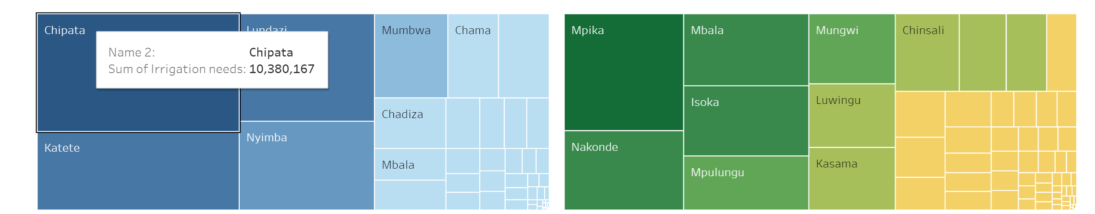
RE4AFAGRI dashboards – desired features (iii)
Possibly, additional visualisation “linked” to the dropdown menus selection and the maps

